Slide 1
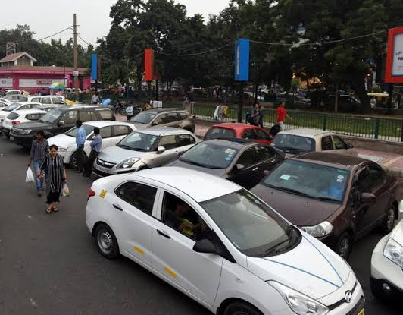
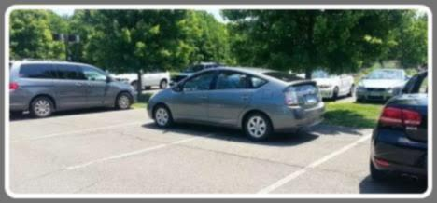
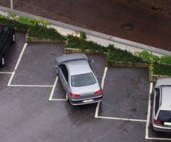
The Problem
Ever struggled to find parking space at your favorite mall?
Ever had your vehicle damaged, tampered with, or stolen?
Many residential society administrations, tolls, business complexes and parking spaces in India lack an automated system for car parking and vehicle monitoring and face an impending problem of illegal car/vehicle parking inside their premises and other security concerns. The need of the hour is to devise a working and affordable model, wherein, when a vehicle passes through a check post the model identifies as many features of the vehicle as possible. With a smart amalgamation of offline and online technologies, the team must make the vehicle parking experience smooth and safe for everyone, while ensuring vehicle security and integrity alongside ethical monetization of the parking.

Slide 2
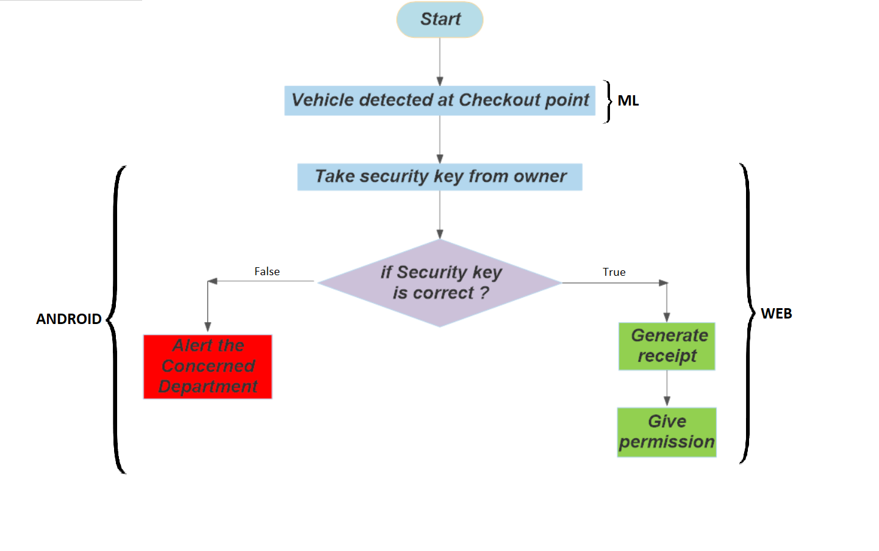
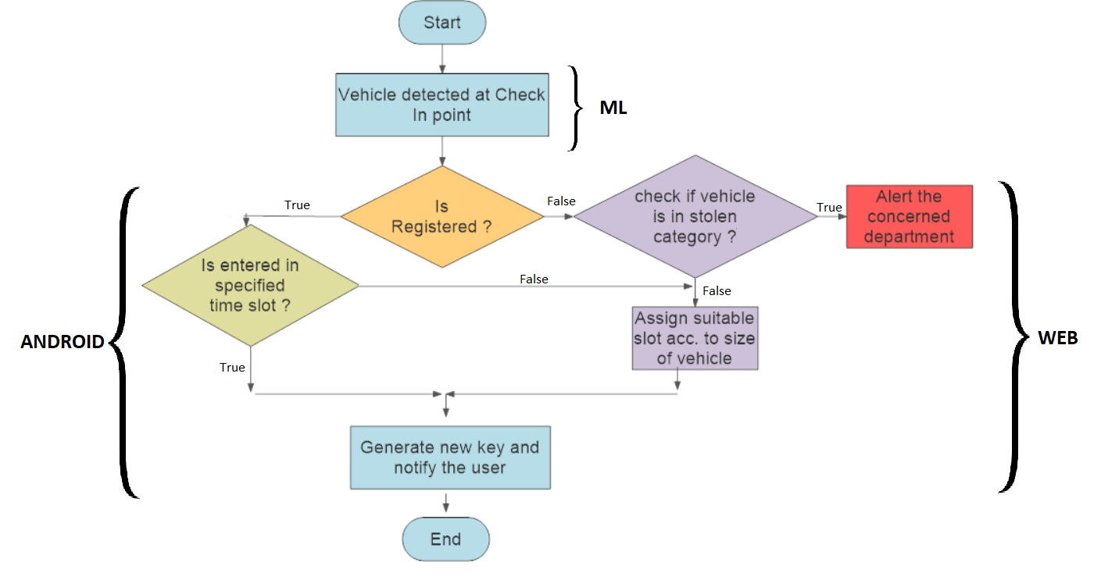
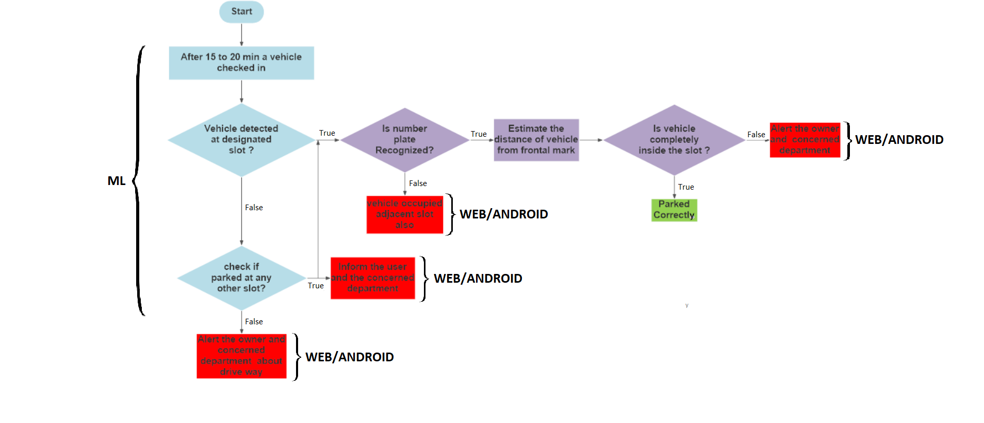
Flowchart Representation
Handling all cases of invalid parking
Process End Representation
Process Start Representation
Notes:
By extracting and detecting the car number plate, the ML Model uses OpenCV extracts the car number from which we determine model and size of the car.
Given that the number doesn’t belong to the database of stolen cars, in which case we will seize the car and report it to the authorities, our algorithm checks if the car is already registered. If it is, we generate it’s one time use key which will exist as long as the car is parked in the system, notify the user of the key, and allow it to go to it’s registered parking slot. If the car is new to the slot, we assign a new slot to it based on the car size, generate it’s one time use key, notify the user of the key and allow the user to move to their newly allotted parking spot. In the event that the user doesn’t possess his mobile phone to access electronic notifications, we will provide a physical one time use token for entry and exit.

Slide 3

Use Cases
Enabling smooth functioning of the parking.
Detecting invalid parking and reporting immediately to owner and concerned department
Automated Allotment of the slot
Space efficient and fully automated parking resulting in more profits.
Slot allocation according to the vehicle’s dimensions.
Less human effort required for smooth functioning of parking system.
Detection of unwanted tampering and complete Security of vehicles
Live monitoring access to user
Unique Digital Security Key
Fostering law and order by identifying stolen vehicles
Notifying the concerned department if vehicle is stolen
Reserved and convenient parking for registered users
Parking Process is faster and convenient for registered users

Slide 4







Technology Stack
ML
Pytessaract
Opencv
Convolutional Neural Networks
Deep Neural Networks
Android
Web
Express
Excel Js
BootStrap
Fast2sms
Database
Firebase
Future Scope
The model isn’t yet able to incorporate parking for 2-wheelers. We aim to include it as we develop the model.
We aim to advance our model to detect and prevent illegal tampering
We aim to include a navigator in the app to guide the users to their designated parking

Slide 5
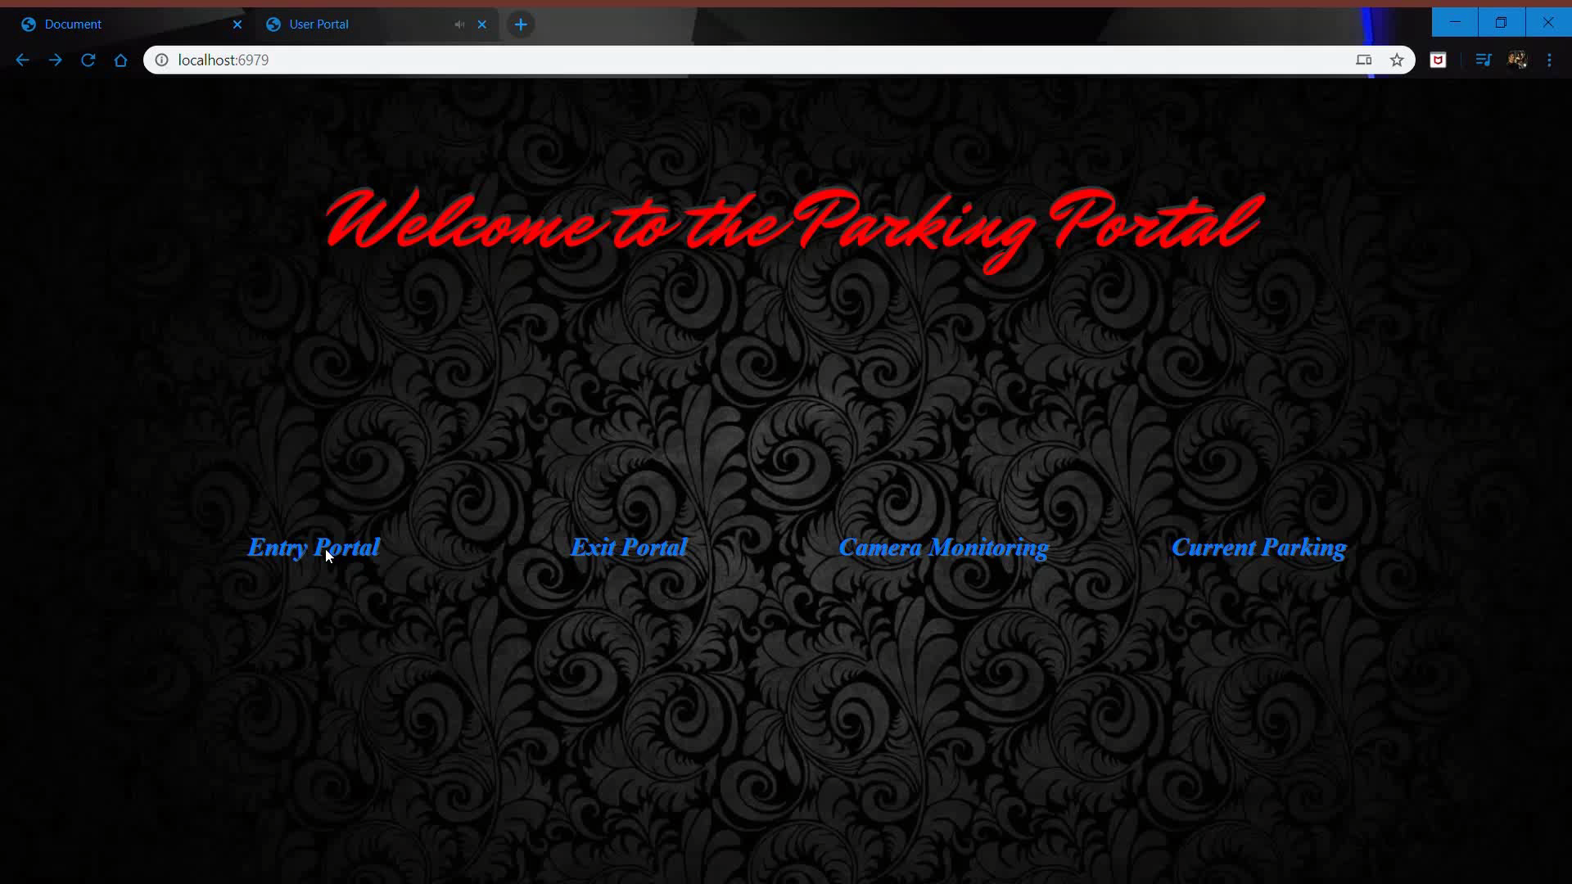
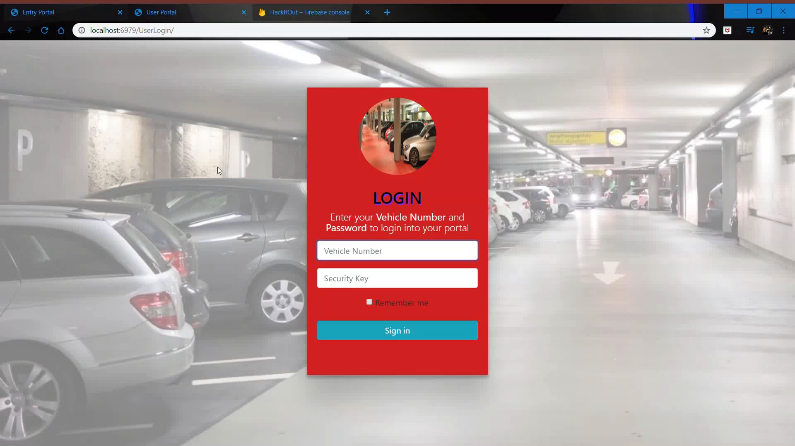


Slide 6

HackItOut

